Slide 1
GIA BAO NGO (Belinda)
Stata Empirical Project
EC 223
FALL 2023
CORRELATION BETWEEN
EDUCATION AND PERSONAL INCOME
Abstract
The overall purpose of this study is to examine the relationship between an individual’s educational attainment and their total personal income in the United States in 2023. Income inequality exists in any society, with education undeniably being one of the most prominent factors. Through linear and logistic regression models, the analysis results suggest a weak positive relationship between education and personal income. Some omitted variables—age, work expenses, marital status, and US citizenship status—can also correlate with income. These findings could help individuals decide whether to pursue more education or seek other benefits in hopes of higher earnings.

Slide 2
INTRODUCTION
To examine the relationship between the continuous variables, educational attainment and total personal income, in the United States using data from IPUMS CPS, ASEC 2023
Key regressor: Educational attainment (educ)
Dependent variable: Total personal income (inctot)
Additional variables:
Continuous: Age (age), Work expenses (wkxpns)
Binary: Marital status (marst), Citizenship status (citizen)

Slide 3
INTRODUCTION
How does an individual’s educational attainment (X) correlate with their total personal income (Y)?
I predict a weak positive relationship between educational attainment and total personal income. As education is a metric for qualification, individuals who have completed more schooling are more likely to earn more. However, there exist other omitted factors correlating with income as well. In this study, I use four additional explanatory variables: age, work expenses, marital status, and citizenship status. Assuming my hypothesis holds, these variables may also have a positive relationship with income: higher age could mean more years of experience, people afford more work expenses if they earn more, married individuals may be married because they were already financially independent, and citizens might make more as finding work as a non-citizen poses many challenges. The findings of this study could help individuals in the US decide whether pursuing more education is the most efficient route to higher earnings, as education is increasingly expensive and, therefore, possibly unaffordable.

Slide 4
DATA DESCRIPTION
Level of observation: Individual
Variable | Variable label | Description; units | Sample mean | Min | Max
Income | inctot | Total pre-tax personal income; $ | $73,043.60 | $-9,999 | $2,051,450
Education | yrs_educ (recoded from educ) | Years of completed schooling; years | 14.17581 | 0 | 21
Age | age | Age at last birthday; years | 43.16474 | 15 | 85
Work expenses | wkxpns | Annual work expenses; $ | $1,479.79 | $0 | $1,612
Marital status | married (recoded from marst) | 1: is married 0: is not married | 0.5694477 | 0 | 1
Citizenship status | uscitizen (recoded from citizen) | 1: is a US citizen 0: is not a US citizen | 0.9045015 | 0 | 1

Slide 5
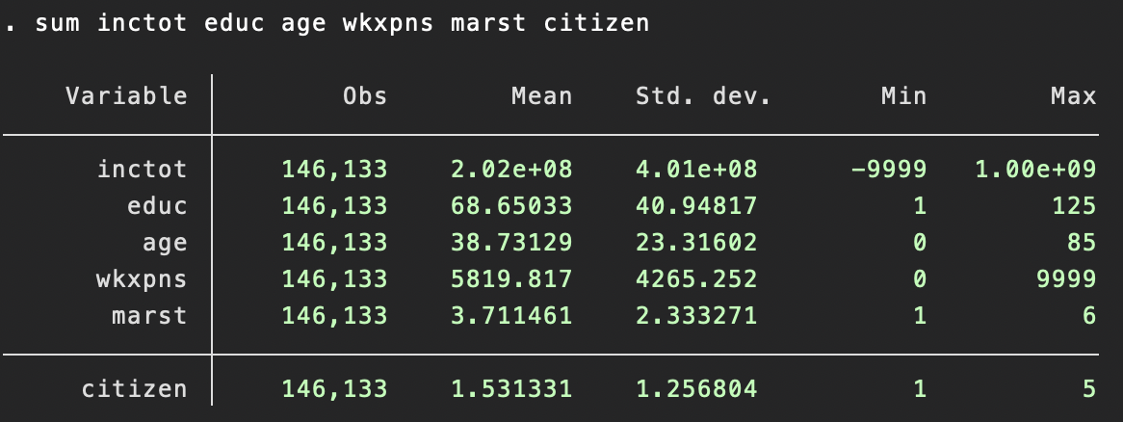
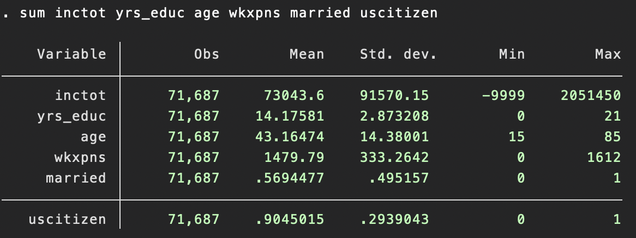
SUMMARY STATISTICS TABLE
Original vs. cleaned data

Slide 6
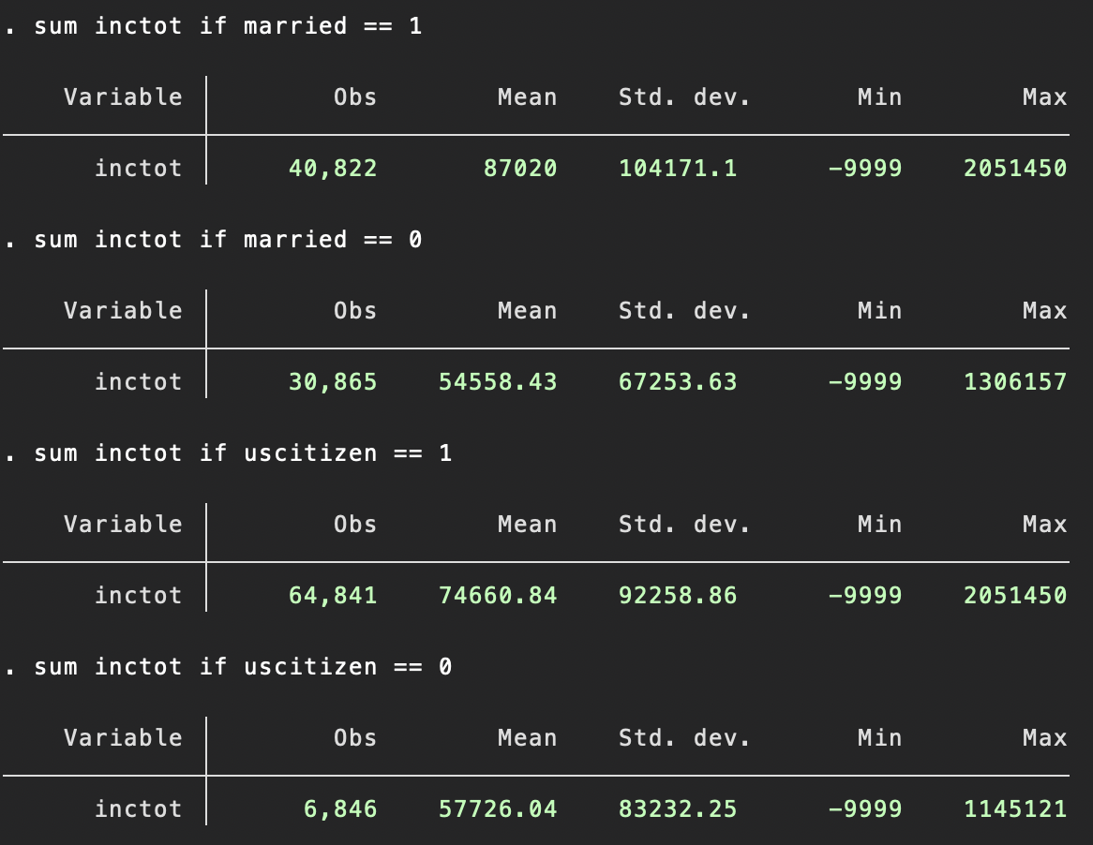
ANALYSIS ON SAMPLE STATISTICS
Income: married vs. unmarried individuals
Income: US citizens vs. non-citizens
The mean income is significantly higher for married ($87,020.00) compared to unmarried ($54,558.43) individuals
Income has a greater range for married individuals, covering the entire sample range ($-9,999 to $2,051,450)
Income has a greater standard deviation for married individuals, displaying greater variability
More married individuals are in the sample
The mean income is significantly higher for US citizens ($74,660.84) compared to non-citizens ($57,726.04)
Income has a greater range for US citizens, covering the entire sample range ($-9,999 to $2,051,450)
Income has a greater standard deviation for US citizens, displaying greater variability
Significantly more individuals are US citizens, almost 10 times higher than non-citizens

Slide 7
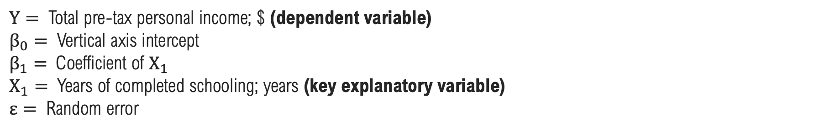
BIVARIATE REGRESSION MODEL
$$Y=β_{0}+β_{1}X_{1}+ε$$
$Y=$ Total pre-tax personal income; $ (dependent variable)
$β_{0}=$ Vertical axis intercept
$β_{1}=$Coefficient of $X_{1}$
$X_{1}=$ Years of completed schooling; years (key explanatory variable)
$ε=$ Random error
Notes:
Minimize sum of squared residuals

Slide 8
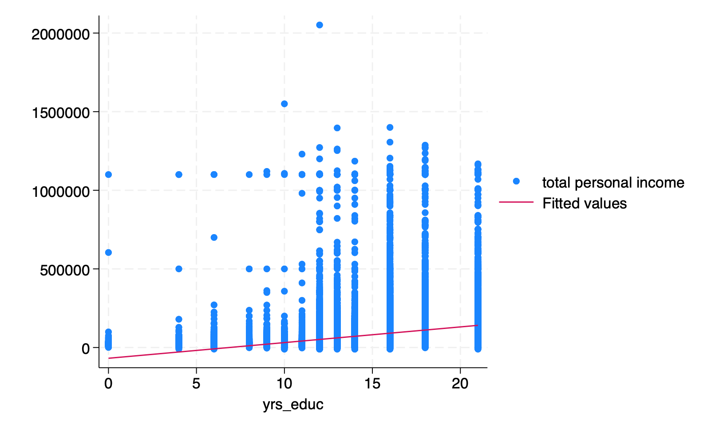
SCATTERPLOT
This scatterplot displays the relationship between years of completed schooling and total personal income. The linear regression line indicates a weak positive relationship between these variables: the more education the individual pursues, the more they earn. Heteroskedasticity is uncertain.

Slide 9
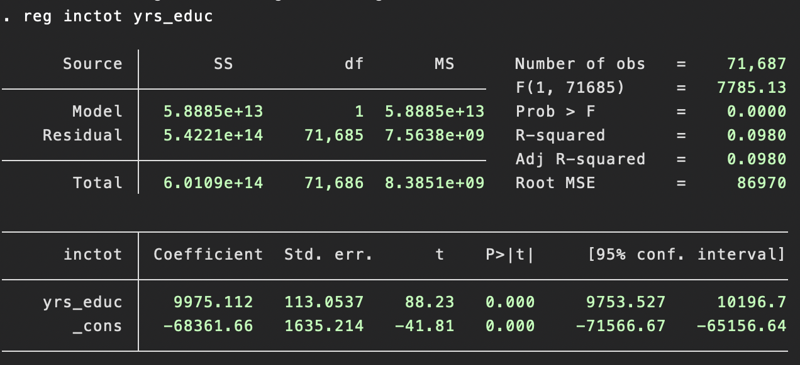
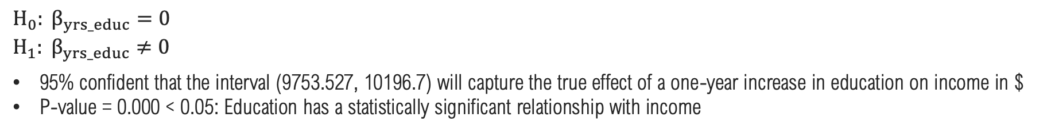
BIVARIATE REGRESSION MODEL
Coefficient of yrs_educ = 9975.112: A one-year increase in education leads to a $9,975.112 increase in income, on average
R-squared = 0.0980: 9.80% of the variability in income can be explained by education (weak correlation)
Root MSE = 86970: A high root MSE value indicates significant uncertainty when explaining income as predictions are far from the measured data. Introducing more explanatory variables will improve model performance.
$$H_{0}: β_{yrs_educ}=0$$
$$H_{1}: β_{yrs_educ}≠0$$
95% confident that the interval (9753.527, 10196.7) will capture the true effect of a one-year increase in education on income in $
P-value = 0.000 < 0.05: Education has a statistically significant relationship with income

Slide 10
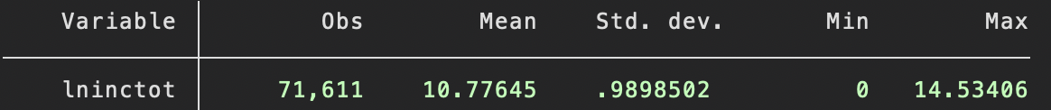
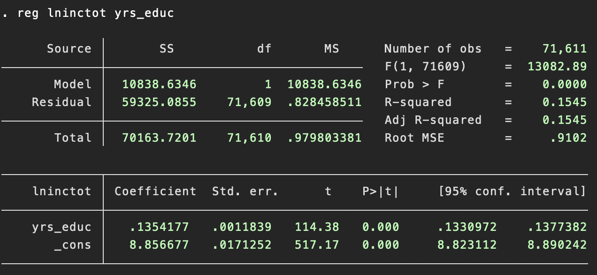
LOG BIVARIATE REGRESSION MODEL
In the previous model, the coefficient of yrs_educ was interpreted as an effect of a one-year increase in education on income
This model regress log income (lninctot) on education (yrs_educ) to be interpreted in terms on elasticity
Coefficient of yrs_educ = 0.1354177: A one-year increase in education leads to a 13.54177% increase in income, on average
This interpretation of percentage point is more informative
R-squared = 0.1545: 15.45% of the variability in log of income can be explained by education (weak correlation)
Root MSE = 0.9102

Slide 11
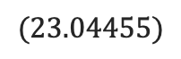
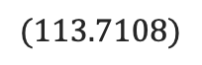
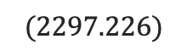
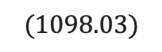
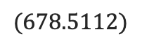
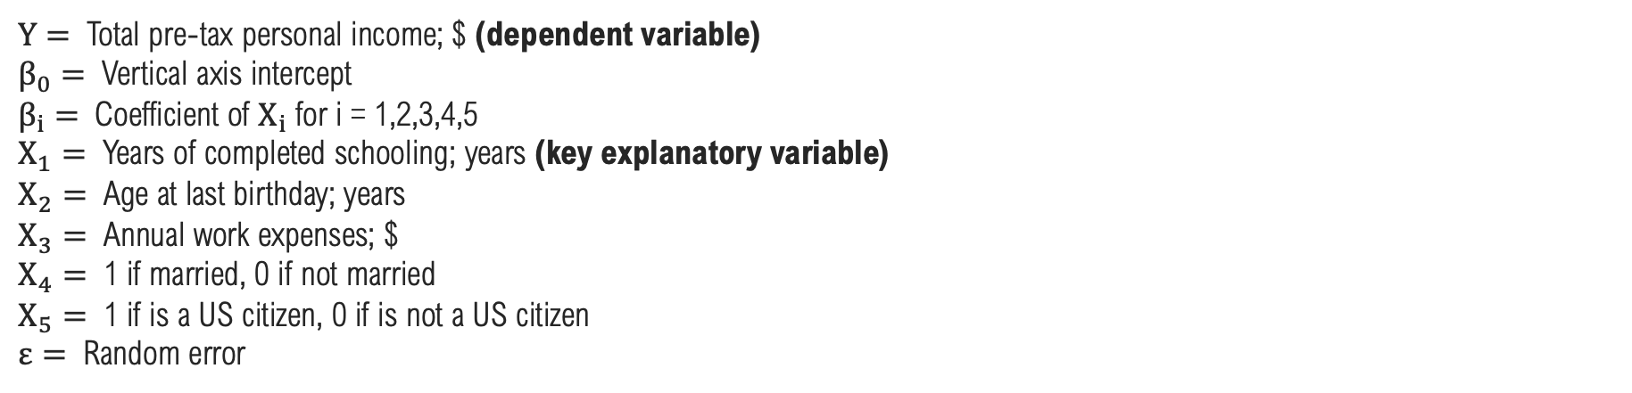
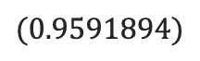
MULTIVARIATE REGRESSION MODEL
General equation
$$Y=β_{0}+β_{1}X_{1}+β_{2}X_{2}+β_{3}X_{3}+β_{4}X_{4}+β_{5}X_{5}+ε$$
Equation for this sample
$$Y=−145874.5+8950.705X_{1}+591.1835X_{2}+38.03677X_{3}+16805.94X_{4}+729.4994X_{5}+ε$$
$$(2297.226)$$
$$(113.7108)$$
$$(23.04455)$$
$$(0.9591894)$$
$$(678.5112)$$
$$(1098.03)$$
$Y=$ Total pre-tax personal income; $ (dependent variable)
$β_{0}=$ Vertical axis intercept
$β_{i}=$Coefficient of $X_{i}$ for i = 1,2,3,4,5
$X_{1}=$ Years of completed schooling; years (key explanatory variable)
$X_{2}=$ Age at last birthday; years
$X_{3}=$ Annual work expenses; $
$X_{4}=$ 1 if married, 0 if not married
$X_{5}=$ 1 if is a US citizen, 0 if is not a US citizen
$ε=$ Random error

Slide 12
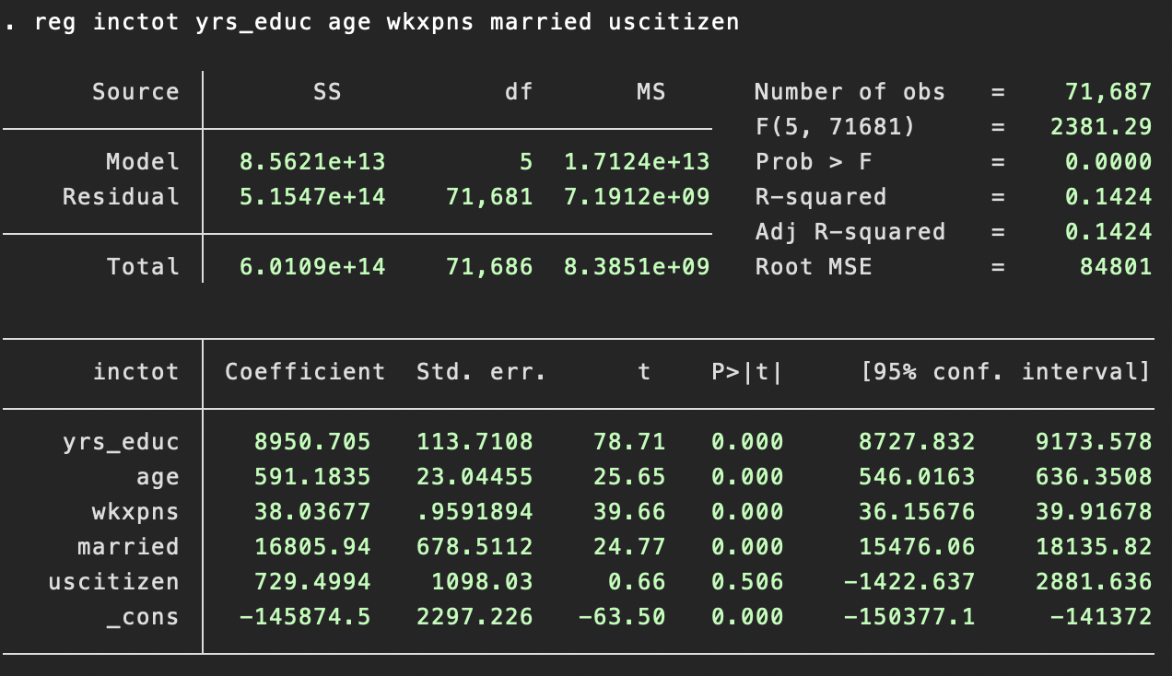
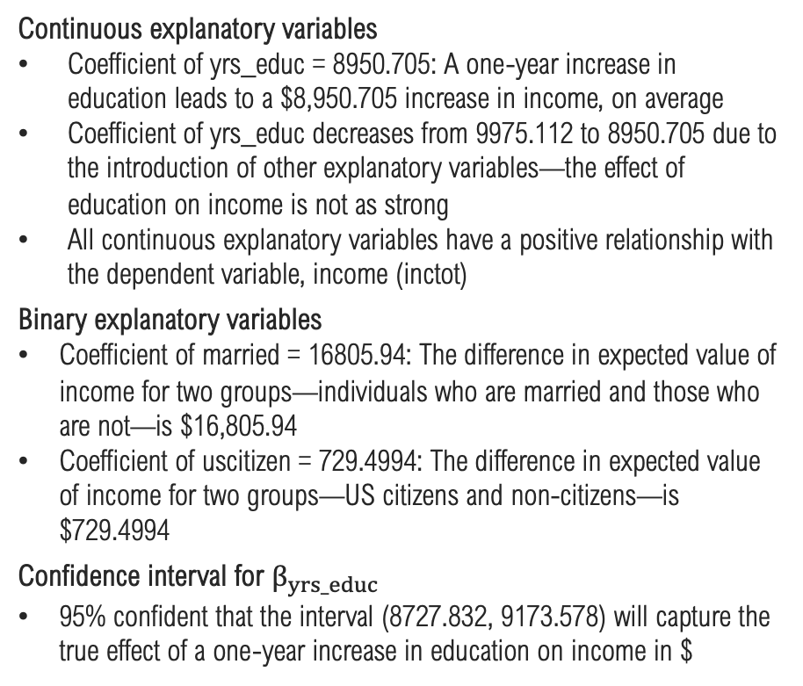
MULTIVARIATE REGRESSION MODEL
Continuous explanatory variables
Coefficient of yrs_educ = 8950.705: A one-year increase in education leads to a $8,950.705 increase in income, on average
Coefficient of yrs_educ decreases from 9975.112 to 8950.705 due to the introduction of other explanatory variables—the effect of education on income is not as strong
All continuous explanatory variables have a positive relationship with the dependent variable, income (inctot)
Binary explanatory variables
Coefficient of married = 16805.94: The difference in expected value of income for two groups—individuals who are married and those who are not—is $16,805.94
Coefficient of uscitizen = 729.4994: The difference in expected value of income for two groups—US citizens and non-citizens—is $729.4994
Confidence interval for $β_{yrs_educ}$
95% confident that the interval (8727.832, 9173.578) will capture the true effect of a one-year increase in education on income in $

Slide 13
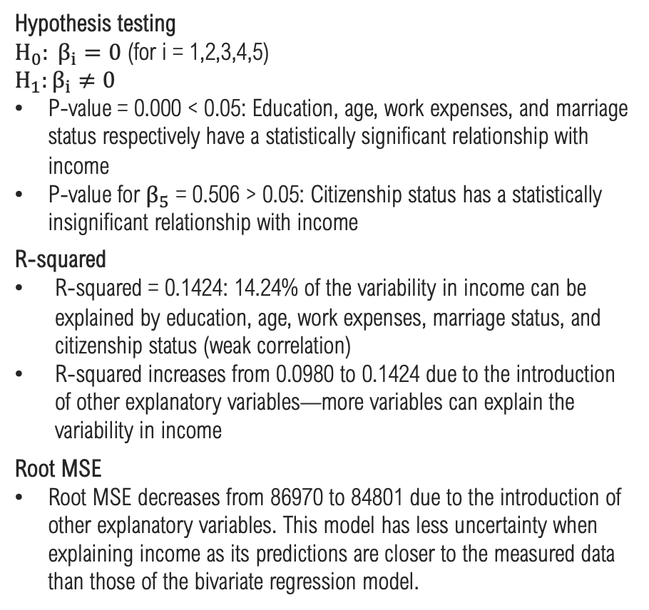
MULTIVARIATE REGRESSION MODEL
Hypothesis testing
$H_{0}: β_{i}=0$ (for i = 1,2,3,4,5)
$$H_{1}:β_{i}≠0$$
P-value = 0.000 < 0.05: Education, age, work expenses, and marriage status respectively have a statistically significant relationship with income
P-value for $β_{5}$ = 0.506 > 0.05: Citizenship status has a statistically insignificant relationship with income
R-squared
R-squared = 0.1424: 14.24% of the variability in income can be explained by education, age, work expenses, marriage status, and citizenship status (weak correlation)
R-squared increases from 0.0980 to 0.1424 due to the introduction of other explanatory variables—more variables can explain the variability in income
Root MSE
Root MSE decreases from 86970 to 84801 due to the introduction of other explanatory variables. This model has less uncertainty when explaining income as its predictions are closer to the measured data than those of the bivariate regression model.

Slide 14
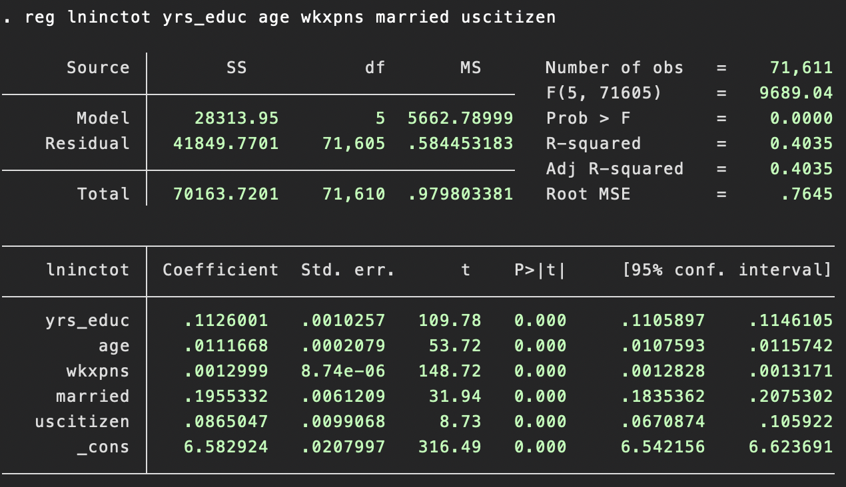
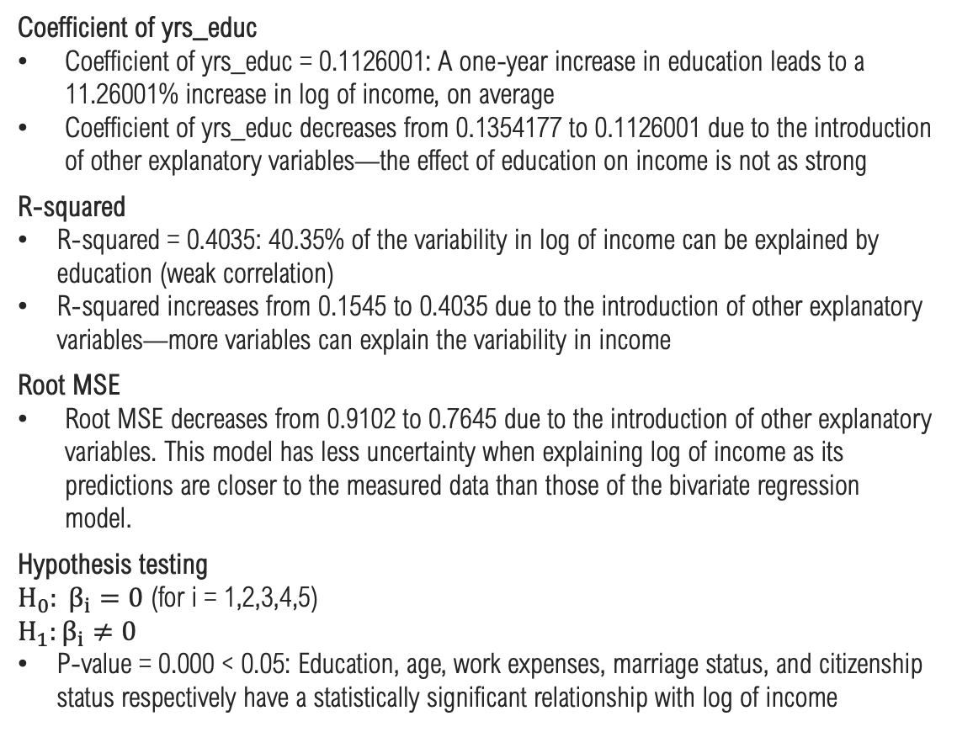
LOG MULTIVARIATE REGRESSION MODEL
Coefficient of yrs_educ
Coefficient of yrs_educ = 0.1126001: A one-year increase in education leads to a 11.26001% increase in log of income, on average
Coefficient of yrs_educ decreases from 0.1354177 to 0.1126001 due to the introduction of other explanatory variables—the effect of education on income is not as strong
R-squared
R-squared = 0.4035: 40.35% of the variability in log of income can be explained by education (weak correlation)
R-squared increases from 0.1545 to 0.4035 due to the introduction of other explanatory variables—more variables can explain the variability in income
Root MSE
Root MSE decreases from 0.9102 to 0.7645 due to the introduction of other explanatory variables. This model has less uncertainty when explaining log of income as its predictions are closer to the measured data than those of the bivariate regression model.
Hypothesis testing
$H_{0}: β_{i}=0$ (for i = 1,2,3,4,5)
$$H_{1}:β_{i}≠0$$
P-value = 0.000 < 0.05: Education, age, work expenses, marriage status, and citizenship status respectively have a statistically significant relationship with log of income

Slide 15
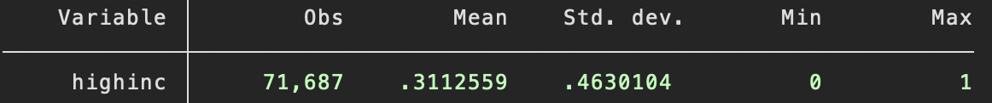
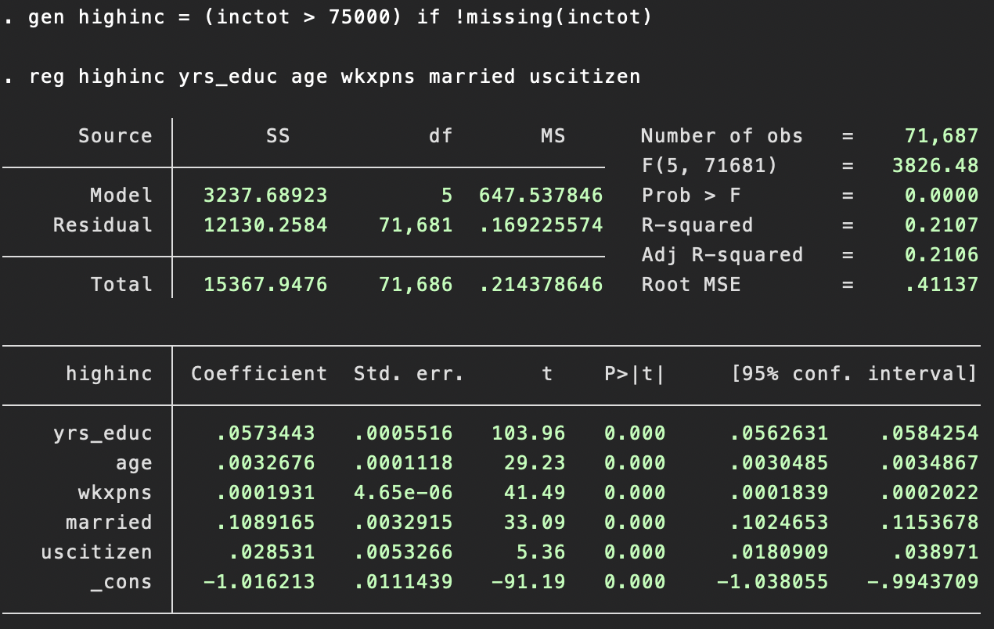
REGRESSION MODEL WITH A BINARY DEPENDENT VARIABLE
Generating a binary variable highinc from the continuous dependent variable inctot
If inctot > 75000, highinc = 1
Else, highinc = 0
Coefficient of yrs_educ = 0.0573443: A one-year increase in education leads to a 0.0573443% increase in the probability of income exceeding $75,000, on average
R-squared = 0.2107: There is a 21.07% variation in the probability of income exceeding $75,000
Linear regression model for different types of dependent variable
For continuous Y, estimating the effect a one-year increase in education on expected value of income
For binary Y, exploring the probability that income exceeds $75,000

Slide 16
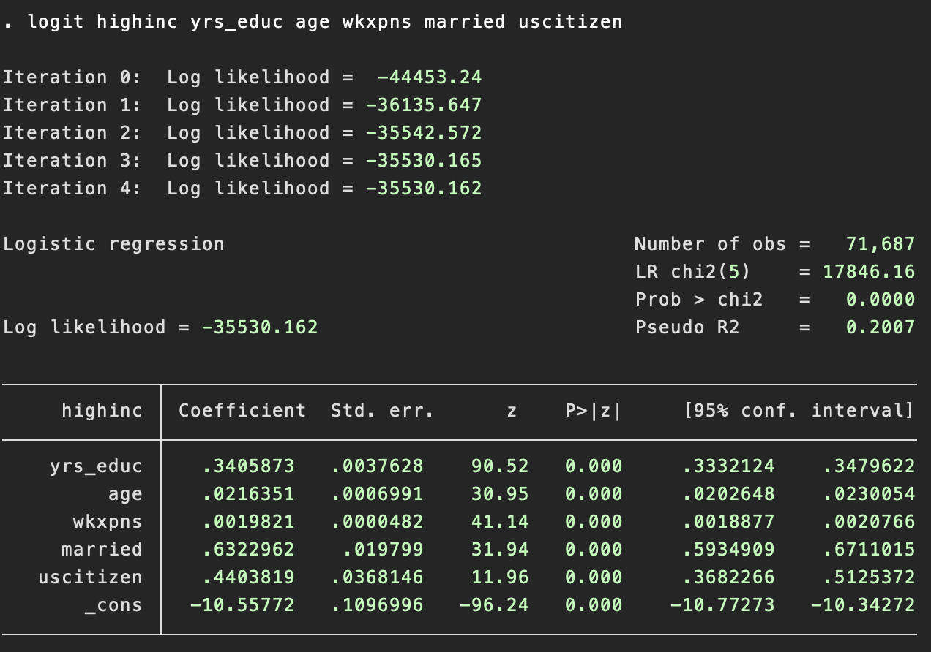
LOGISTIC REGRESSION MODEL
Fitting an S-shaped curve to model the probability of Y = 1 (highinc)
$P(Y=1\text{|}X_{1},X_{2},X_{3},X_{4},$ $X_{5})=F(β_{0}\text{+}β_{1}X_{1}\text{+}β_{2}X_{2}\text{+}β_{3}X_{3}\text{+}β_{4}X_{4}\text{+}β_{5}X_{5})=\frac{1}{{1+e}^{{−(β}_{0}\text{+}β_{1}X_{1}\text{+}β_{2}X_{2}\text{+} β_{3}X_{3}\text{+}β_{4}X_{4}\text{+}β_{5}X_{5})}}$
This model doesn’t allow interpretation of the coefficients of explanatory variables as estimates of the effect on the dependent variable
Can interpret the signs of the coefficients: a positive coefficient indicates a positive relationship between the explanatory and the dependent variables
Prob > chi2 = 0.0000 < 0.05: this model has relevant explanatory power
yrs_educ has the highest z value = 90.52: yrs_educ has the highest relevance in relation with highinc
All P-value = 0.000 < 0.05: Education, age, work expenses, marriage status, and citizenship status respectively have a statistically significant relationship with income
Notes:
Prob > chi2: tests if the combined effect of all the variables in the model is different from 0

Slide 17
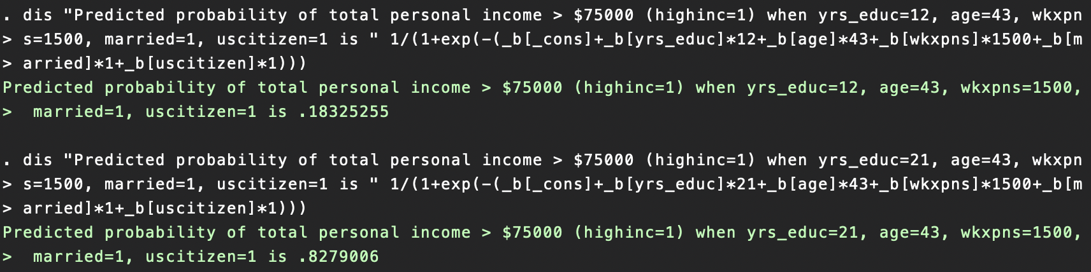
Predicting probability of total personal income > $75,000 for an individual with lower vs. higher education
Considering the probability of total personal income exceeding $75,000 given an individual is 43 years old, has annual work expenses of $1,500, is married, and is a US citizen, with either a high school diploma or a doctorate’s degree
Probability of high income (highinc=1) for an individual with a high school diploma is 18.325255% (relatively low)
Probability of high income (highinc=1) for an individual with a doctorate’s degree is 82.79006% (relatively high)
Results make sense, as an individual with higher educational attainment should expect to earn higher

Slide 18
SUMMARY & CONCLUSIONS
Based on the OLS linear regression model, my findings support my hypothesis that individuals who have completed more schooling are more likely to earn more, controlling for additional variables such as age, work expenses, marital status, and citizenship status
The multivariate regression model suggests that a one-year increase in education leads to a $8,950.705 increase in income, on average and controlling for additional variables
The multivariate logarithmic regression suggests that a one-year increase in leads to a 11.26001% increase in log of income, on average and controlling for additional variables
Only the multivariate regression discovers that citizenship status does not have a statistically significant correlation with income
The model with the binary dependent variable (highinc=1 if income exceeds $75,000, highinc=0 otherwise suggests that a one-year increase in education leads to a 0.0573443% increase in the probability of income exceeding $75,000
The logistic model suggests that the probability of income exceeding $75,000 (highinc=1) for an individual with a high school diploma is 0.18325255, while for an individual with a doctorate’s degree is 0.8279006
This project provides empirical evidence to potentially help individuals decide whether to pursue more education or other paths in hopes of higher earnings
IPUMS CPS data citation
Sarah Flood, Miriam King, Renae Rodgers, Steven Ruggles, J. Robert Warren, Daniel Backman, Annie Chen, Grace Cooper, Stephanie Richards, Megan Schouweiler and Michael Westberry. IPUMS CPS: Version 11.0 [dataset]. Minneapolis, MN: IPUMS, 2023.
https://doi.org/10.18128/D030.V11.0

